Slide 1
Transform and Conquer
Solve problem by transforming into:
a more convenient instance of the same problem (instance simplification)
presorting
Gaussian elimination
AVL Tree(still a binary tree)
a different representation of the same instance (representation change)
2-3 Tree
heaps and heapsort
a different problem with available algorithms (problem reduction)
reductions to graph problems
Notes:
Instance simplification: the problem is still same but with a more simple input
Change the original data structure to a new one that have efficient algorithm.

Slide 2
Instance Simplification - Presorting
Solve problem by transforming into another simpler/easier instance of the same problem
Presorting:
Why: Many problems involving lists are easier when list is sorted.
When: A preprocessing step if multiple operations of following are needed:
searching
computing the median (selection problem)
computing the mode
finding repeated elements

Slide 3
Example 1: Searching Problem
Find a value v in A[1],…A[n].
Brute-force search:
Sequential search with
worst case Θ(n).
Presorted search T(n)=T_{sort}(n)+ T_{search}(n)
= Θ(n log n)+ Θ(log n) = Θ(n log n)
For a single search, the presorted search is inferior to the brute-force search
For repeated searches in the same list, presorted search may be more efficient because the sorting need not be repeated
Binary search

Slide 4
Example 2: Selection Problem
Find the k^{th} smallest element in A[1],…A[n]. Special cases:
minimum: k = 1
maximum: k = n
median: k = n/2
Partition-based algorithm (Variable decrease & conquer):
worst case: T(n) =T(n-1) + (n+1) → Θ(n²)
best case: Θ(n)
average case: T(n) =T(n/2) + (n+1) → Θ(n)
Presorting-based algorithm
sort list
return A[k]
Θ(nlogn) + Θ(1) = Θ(nlogn)
Brute-force Θ(n)
Notes:
Keep doing partitioning until the pivot is at kth position. C(n)=C(n/2)+n+1 Θ(n)

Slide 5
Notes on Selection Problem
Partition-based algorithm (Variable decrease & conquer):
worst case: T(n) =T(n-1) + (n+1) → Θ(n²)
best case: Θ(n)
average case: T(n) =T(n/2) + (n+1) → Θ(n)
Presorting-based algorithm: Ω(nlgn) + Θ(1) = Ω(nlgn)
Special cases of max, min: brute-force algorithm is better Θ(n)

Slide 6
Example 3: Finding Repeated Elements/Array Uniqueness
Presorting-based algorithm:
Sort the array
Scan array to find repeated adjacent elements:
Notes:
Brute force algorithm needs to compare each element with all the other elements

Slide 7
Example 3: Finding Repeated Elements/Array Uniqueness
Brute force algorithm:
Worst case: Θ(n²)
Presorting-based algorithm:
Sort the array: Θ(nlogn)
scan array to find repeated adjacent elements: Θ(n)
Conclusion: Presorting yields significant improvement
Θ(nlogn)
Notes:
Brute force algorithm needs to compare each element with all the other elements

Slide 8
Example 4: Computing A Mode
A mode is a value that occurs most often in a given list of numbers
For example: the mode of [5, 1, 5, 7, 6, 5, 7] is 5
Brute-force technique: construct a list to record the frequency of each distinct element
In each iteration, the i-th element is compared to the stored distinct elements. If a matching is found, its frequency is incremented by 1. Otherwise, current element is added to the list as a distinct element
Worst case complexity Θ(n²), when all the given n elements are distinct

Slide 9
Example 4: Computing A Mode With Presorting Algorithm
How many elements have the same value

Slide 10
Example 4: Complexity of PresortMode()
Step1: Sorting Θ(nlogn)
Step2: Θ(n) since each element will be visited once for comparison
Overall complexity of presortMode is Θ(nlogn)
Much more efficient than the brute-force algorithm Θ(n²)

Slide 11
Summary: Presorting
Solve problem by transforming into another simpler/easier instance of the same problem
For a single operation:
Searching: Θ(n log n) inferior to brute-force search Θ(n)
Selection problem: Θ(n log n) inferior to Partition-based selection Θ(n)
Finding repeated elements: Θ(n log n) better than brute-force Θ(n²)
computing the mode: Θ(n log n) better than brute-force Θ(n²)
For multiple operations on the same list, presorting is preferred
Efficient sorting algorithms should be employed such as MergeSort.

Slide 12


Representation Change – Balanced Binary Search Trees
Search a Key in a Binary Search Tree
Basic operation:
# of comparisons in the worst case:
key comparison
$$h+1$$
$$\log\left|V\right|≤h≤\left|V\right|−1$$
Worst case: the tree degrades to a singly linked list Θ(|V|)
Average case: Θ(log|V|)
k
Same as sequential search
<k
>k
How we can improve it?
Notes:
The average case depends on the height of the tree
1.41 lg n = 2 ln n
All operations: worst case # key comparisons = h + 1
lg n ≤ h ≤ n – 1 with average (random files) 1.41 lg n

Slide 13
Representation Change – Balanced Binary Search Trees (AVL Trees)
The AVL tree is named after its two inventors, G.M. Adelson-Velsky and E.M. Landis, who published it in their 1962 paper "An algorithm for the organization of information.“
AVL tree is a balanced binary search tree.
An AVL tree
Not an AVL tree
The number shown above the node is its balance factor balance factor = height of left subtree - height of right subtree
For an AVL tree, |balance factor| <=1
Notes:
Named after the inventors G.M. Adelson-Velskii and E.M. Landis

Slide 14
Maintain the Balance of An AVL Tree
When?
Insert a new node or delete a node may make it unbalanced – the balance factors of one or more nodes become +2 or -2.
How?
By rotation operations
Four types of rotations
two of them are mirror images of the other two
Where?
Rotate a subtree rooted at the unbalanced node (whose balance factor has become either +2 or -2) closest to the change

Slide 15
Four Types of Rotations for Three-Node AVL Trees
Case 1: Balance factors of the unbalanced node and its child have same sign
3
1
Type 1: Single right rotation
Type 2: Single left rotation

Slide 16
Four Types of Rotations for Three-Node AVL Trees
Case 2: Balance factors of the unbalanced node and its child have different signs
2
2
Type 4: Double right–left rotation
3
3
-1
1
R
1
L
>
2
0
0
2
1
(c)
Type 3: Double left-right rotation

Slide 17
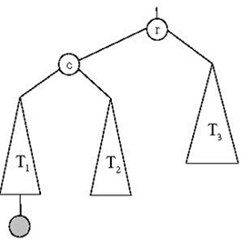
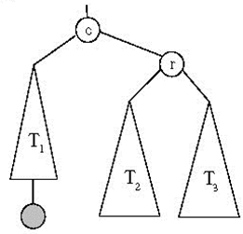
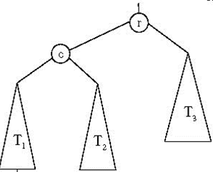
General Case: Single R-rotation
Height(T₁)=Height(T₂)=Height(T₃)
2
0
1
1
0
0
Single R-rotation
Insert a node
Last inserted node
Notes:
The last example is the simplest case of rotation. This one is more general and realistic

Slide 18
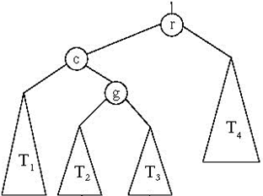
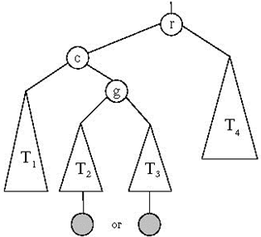
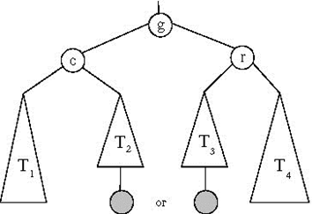
General Case: Double LR-rotation
1
2
0
0
-1
0/1
-1/0
Insert a node
Double LR-rotation
Last inserted node

Slide 19
Example: Construct an AVL Tree for the List [5, 6, 8, 3, 2, 4, 7]
Which one should be rotated?

Slide 20
Example: Construct an AVL Tree for the List [5, 6, 8, 3, 2, 4, 7]

Slide 21
Continued [5, 6, 8, 3, 2, 4, 7]

Slide 22
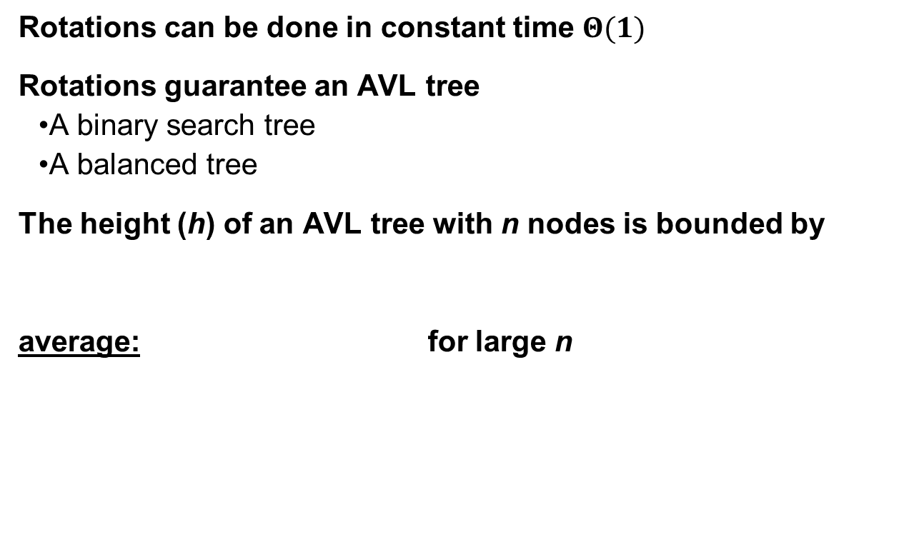
Notes on AVL Tree

Slide 23
Operations in an AVL Tree
Searching: Θ(logn)
Insertion: a new node is inserted at the leaf position
Searching Θ(logn)
Rebalance (bottom up) Θ(logn)
Deletion:
Searching: Θ(logn)
Deletion:
A leaf or a non-leaf node with only one child, remove it. Θ(1)
Otherwise, replace it with either the largest in its left subtree or the smallest in its right subtree, and remove that node. Θ(logn)
Rebalance Θ(logn)
Drawbacks: need rotation frequently to rebalance the tree
Notes:
For rebalance, you need to calculate the balance factors and find which node is unbalanced. But you don’t need to search all nodes. The nodes affected by the insertion or deletion are those who is either ancestor or descendant of the node been inserted or deleted.

Slide 24
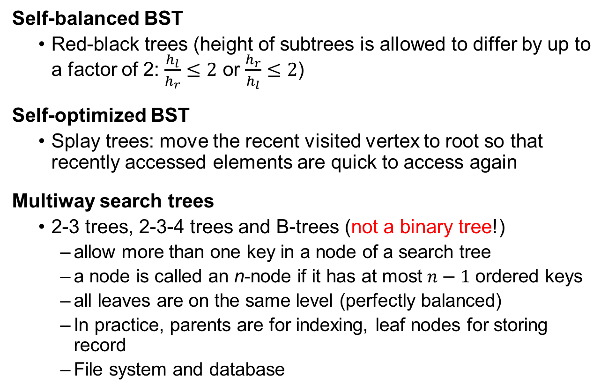
Other Search Trees
Notes:
Red-black tree
The leaf nodes of red–black trees do not contain data. These leaves need not be explicit in computer memory—a null child pointer can encode the fact that this child is a leaf—but it simplifies some algorithms for operating on red–black trees if the leaves really are explicit nodes. To save memory, sometimes a single sentinel node performs the role of all leaf nodes; all references from internal nodes to leaf nodes then point to the sentinel node.
A node is either red or black.
The root is black. (This rule is sometimes omitted. Since the root can always be changed from red to black, but not necessarily vice-versa, this rule has little effect on analysis.)
All leaves (NIL) are black. (All leaves are same color as the root.)
Every red node must have two black child nodes.
Every path from a given node to any of its descendant leaves contains the same number of black nodes.

Slide 25
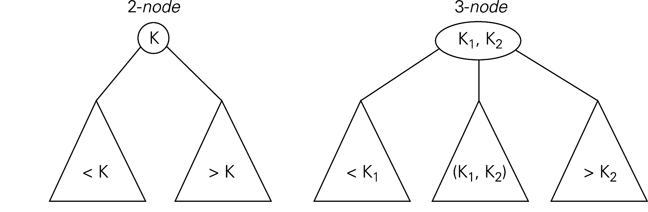
2-3 Tree – A Multiway Search Tree
A search tree may have 2-node and 3-node
Height balanced – all leaves are on the same level
Constructed by successive insertions of keys
A new key is always inserted into a leaf of the tree. If the leaf is a 3-node (with two keys) already, it’s split into two with the middle key promoted to the parent.

Slide 26
An Example of 2-3 Tree Construction
Construct a 2-3 tree for the list 9, 5, 8, 3, 2, 4, 7

Slide 27
Note on 2-3 Tree
Height of the tree log₃ (n + 1) - 1 ≤ h ≤ log₂ (n + 1) - 1
Time efficiency
Search, insertion, and deletion are in Θ(log n)
The idea of 2-3 tree can be generalized by allowing more keys per node
2-3-4 trees
B-trees

Slide 28
Priority Queues
A priority queue is the ADT (abstract data type) of an ordered set with the operations:
find element with highest priority
delete element with highest priority
insert element with assigned priority
Applications:
Scheduling in computer operating system, traffic management, communication networks
Critical data structure for implementing many algorithms
Prim’s algorithm
Dijkstra’s algorithm
Huffman coding
Heaps are very good for implementing priority queues

Slide 29
Heapsort
Definition:
A heap is a binary tree with the following conditions:
(1) it is essentially complete: all its levels are full except possibly the last level, where only some rightmost leaves may be missing
(2) The key at each node is ≥ keys at its children

Slide 30
An Example:
Which tree is a max heap, why?

Slide 31
Definition implies
Given n, there exists a unique binary tree with n nodes that is essentially complete, with h= log₂n
Parent dominate
Maxheap
The parent has a value larger or equal than its children
The root has the largest key
Don’t confuse it with a BST
There is no relationship between the left and right subtrees
The subtree rooted at any node of a heap is also a heap
Priority queue
A useful structure in many algorithms

Slide 32
Heap Implementation
A heap can be implemented as an array H[1..n] by recording its elements in the top-down left-to-right fashion.
Leave H[0] empty
First elements are parental node keys and the last elements are leaf keys
i-th element’s children are located in positions 2i and 2i+1
Index
value
0 1 2 3 4 5 6
10 5 7 4 2 1

Slide 33
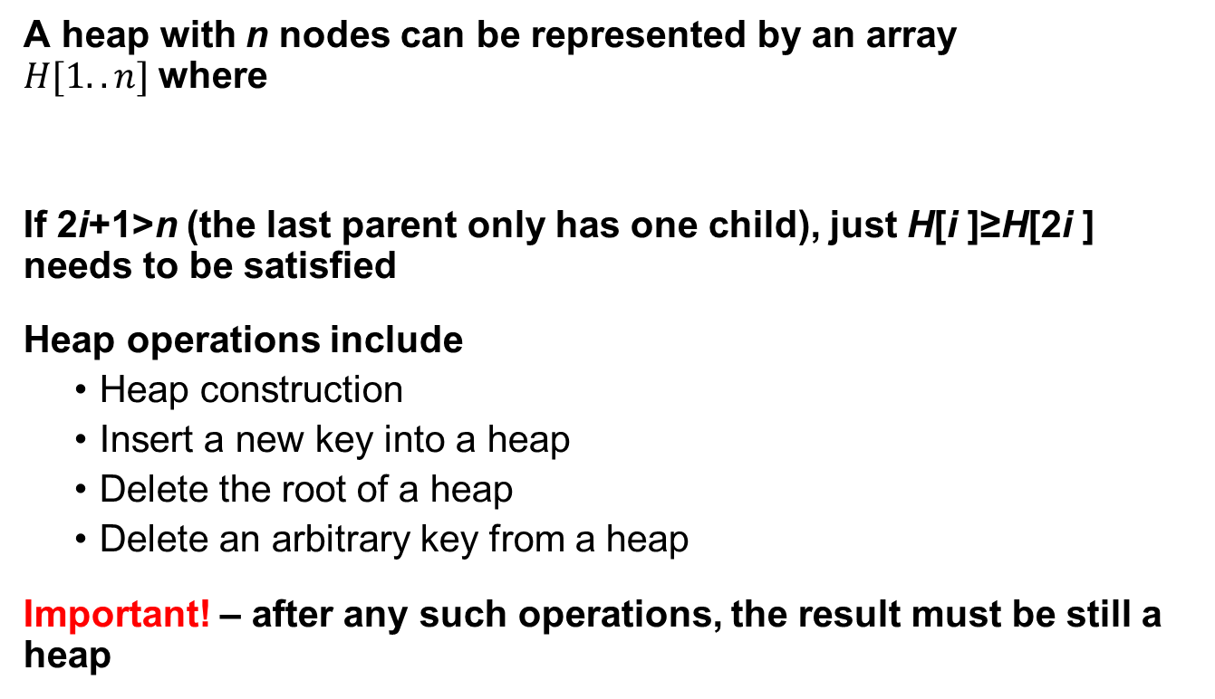
Therefore

Slide 34
Heap Construction -- Bottom-up Approach
Heap Construction -- Construct a heap for a given list of keys
Initialize an essentially complete binary tree with the given order of the n keys
Starting from the last parental node to the first parental node, check whether
If not, swap parental and child keys to satisfy this requirement
Note that when checking a certain parental key and the if it is swapped with one child, we need to keep checking this key at its new location until no more swap is required or a leaf key is reached

Slide 35
An Example:

Slide 36
Another Example: {2 4 5 3 1 9 7}
2
2
2
4
5
4
5
4
9
3
1
9
7
8
1
9
7
8
1
5
7
8
6
3
6
3
6
2
2
9
8
9
8
9
8
2
4
1
5
7
6
1
5
7
6
1
5
7
3
6
3
4
3
4
9
8
7
6
1
5
2
3
4

Slide 37
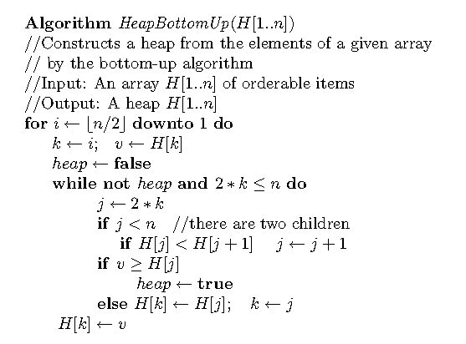
HeapBottomUp Code

Slide 38
Algorithm Efficiency
In the worst case, the tree is complete, i.e, n=2^{k}-1
The height of the tree
In the worst case, each key on level i of the tree will travel to leaf level h
Two key comparisons (finding the larger children and determine whether to swap with the parental key) are needed to move down one level (level i has 2^{i} keys)
The level above the leaf level
The root
Notes:
For each key (2^i) in each level (h levels), it will travel down to h-i levels. H level doesn’t need because they are leaf nodes.

Slide 39
Heap Construction – Top-down Approach
It is based on the operation of inserting a new item to an existing heap, and maintain a heap
Inserting a new key to the existing heap (analogue to insertion sort) is achieved by
Insert the new key as the last element in array H as a leaf of the binary tree
Compare this new key to its parent and swap if the parental key is smaller
If such a swap happened, repeat this for this key with its new parent until there is no swap happened or it gets to the root

Slide 40
An Example:
Insert a new key 10 into the heap with 6 keys [9 6 8 2 5 7]

Slide 41
Note
The time efficiency of each insertion algorithm is because the height of the tree is Θ(log₂n)
A heap can be constructed by inserting the given list of keys into the heap (initially empty) one by one.
Construct a heap from a list of n keys using this insertion algorithm, in the worst case, will take the time

Slide 42
Bottom-up Versus Top-down
Time efficiency:
Bottom-up
Top-down
Space:
Bottom-up: fixed size n+1 array
Top-down: need to allocate array every time of insertion
When we use top-down?
The top-down heap construction is less efficient than the bottom-up heap construction
The application of priority queue.

Slide 43
Delete an Item From the Heap
Let’s consider only the operation of deleting the root’s key, i.e., the largest key
It can be achieved by the following three consecutive steps
(1) Exchange the root’s key with the last key K of the heap
(2) Decrease the heap’s size by 1 (remove the last key)
(3) “Heapify” the remaining binary tree by shifting the key K down to its right position using the same technique used in bottom-up heap construction (compare key K with its child and decide whether a swap with a child is needed. If no, the algorithm is finished. Otherwise, repeat it with its new children until no swap is needed or key K has become a leaf)

Slide 44
An Example:
Delete the largest key 9

Slide 45
Notes On Key Deletion
The required # of comparison or swap operations is no more than the height of the heap. The time efficiency of deleting the root’s key is then
Question: How to delete an arbitrary key from the heap?
Search for the key
It is similar to the three-step root-deletion operation
Exchange with the last element K
“Heapify” the new binary tree. But it may be shift up or down, depending on the value of K

Slide 46
Heapsort
Two Stage algorithm to sort a list of n keys
First, heap construction
Second, sequential root deletion (the largest is deleted first, and the second largest one is deleted second, etc …)

Slide 47
10
1
1
Step1
6
8
8
Step2
6
8
6
2
5
7
4
2
5
7
4
2
5
7
4
1
10
8
8
Step3
Step5
6
1
6
7
2
5
7
4
2
5
1
4

Slide 48
8
4
4
Step1
Step2
7
6
7
6
7
6
2
5
1
4
2
5
1
8
2
5
1
7
Step3
6
4
2
5
1

Slide 49
7
1
1
Step1
4
6
4
Step2
6
4
6
2
5
1
2
5
7
2
5
6
6
Step3
4
Step4
4
1
5
2
5
2
1

Slide 50
6
1
1
Step1
Step2
4
5
4
5
4
5
2
2
6
2
1
5
5
Step3
Step4
1
4
2
4
2
1

Slide 51
5
1
1
Step1
Step2
2
4
2
4
2
4
1
5
Step3
4
2
1

Slide 52
1
1
4
Step1
Step2
1
2
4
2
2
2
Step3
1

Slide 53
Notes on Heapsort
Time efficiency:
Worst case
Average case efficiency is also
Advantage: in place – no additional space needed
Disadvantage: not stable

Slide 54
Problem Reduction
This variation of transform-and-conquer solves a problem by a transforming it into different problem for which an algorithm is already available.
To be of practical value, the combined time of the transformation and solving the other problem should be smaller than solving the problem as given by another method.

Slide 55
Examples of Solving Problems by Reduction
computing lcm(m, n) via computing gcd(m, n)
counting number of paths of length n in a graph by raising the graph’s adjacency matrix to the n-th power
transforming a maximization problem to a minimization problem and vice versa (also, min-heap construction)
linear programming
reduction to graph problems (e.g., solving puzzles via state-space graphs)

Slide 56

55 mod 4 = 3

